Slide 1
ANALYSIS OF CATEGORICAL DATA
Assoc. Prof. Susan Balaba Tumwebaze
Dr. Thomas L. Odong
Dr. Hellen Namawejje

Slide 2
Chi-square test of independence
The chi-square is used to test the independence between two categorical variables
Used to compare multiple observed proportions to multiple expected proportions, in a situation where the variable has two or more categories.
Question: what is observed proportions/frequency and expected proportions/frequency?

Slide 3
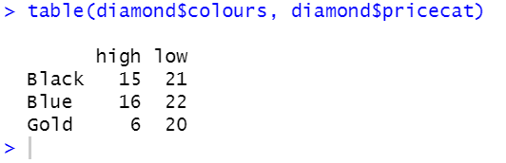
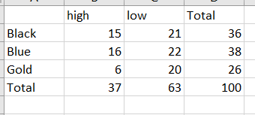
Contingency table/Cross-tabulation
The data are in the form of frequencies (counts)
The observations are organized in cross-tabulated categories, these are the observed frequencies
We need to compute the total rows and columns

Slide 4
Chi-square test
Areas in which the Chi-square test for significance is commonly applied are:
Tests for independence of association
Tests for equality of proportions in more than two populations
Tests for goodness-of-fit
The Chi-square test statistic measures the extent to which the observed and expected frequencies differ.

Slide 5
Analysis of Categorical data
Categorical data refers to observations that are classified into categories so that the data set consists of frequency counts for each category.
It is desirable to know whether the classification of an individual according to one system is independent of its classification by the other system.

Slide 6
Analysis of Categorical data
For example in the independence of species and infection can be interpreted to mean that there is no difference in infection rate between species (i.e., infection rate does not depend on species).
The hypothesis that two or more classifications are independent can be tested by chi-square.

Slide 7
Analysis of Categorical data
Example: A batch of 1500 wooden stakes were divided at random into three groups of 500 each. Each group received a different termite-repellent treatment. The treated stakes were driven in the ground at locations selected at random. Two years later the stakes were examined for termites and data are summarised below

Slide 8
Analysis of Categorical data
Groups | Group 1 | Group 2 | Group3 | Subtotals
Attached by termites | 193 | 148 | 210 | 551
Not attached by termites | 307 | 352 | 290 | 949
Subtotals | 500 | 500 | 500 | 1500
The frequency counts that arise from a classification of sample observation according to two or more characteristics are called cross-tabulated data or contingency table.
The above contingency table has 2 rows and 3columns which results in a 2 X 3 contingency table

Slide 9
Test for independence
Step One: Hypothesis
H0: two classifications are independent (no association)
H1: the two classifications are not independent (association)
Step Two:
Calculate the expected values= (row total*column total)/grand total

Slide 10
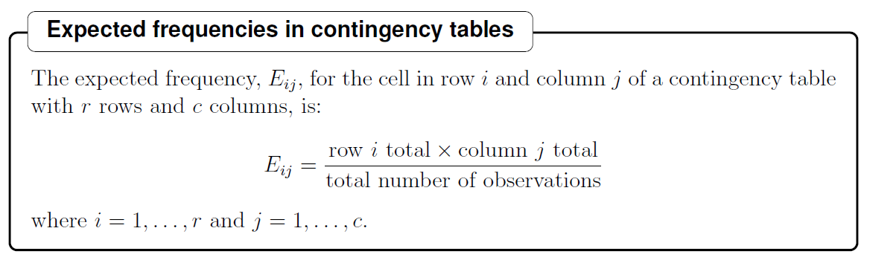
Expected Frequencies
Expected frequency is obtained by multiplying the product of the “marginal probabilities by n, the total number of observations.

Slide 11
Step Three:
Calculate the deviations for each cell of the table (Observed frequency-Expected).
Step Four:
Calculate the chi-square statistic (X²⁾
X² = ∑{(O-E)SQ}/E for all cells

Slide 12
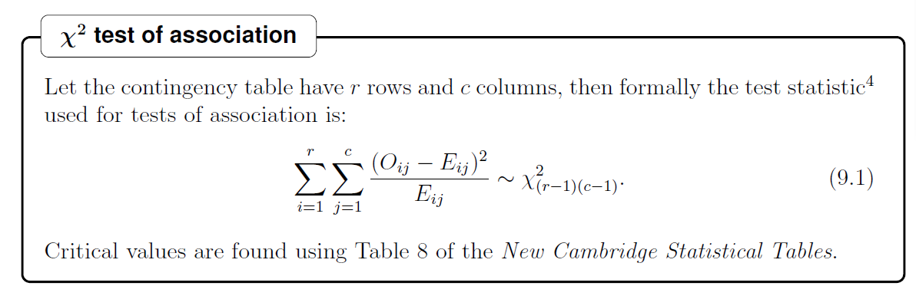
Chi-Square_Test statistics

Slide 13
Test for independence
Degrees of freedom= (r-1)(c-1)
=(2-1)(3-1)=2
Chi-square (X²) for this example = 17.66 on 2 df
Tabulated chi-square (X²)= 5.99 on 2 degrees of freedom at α=0.05

Slide 14
Test for independence
Conclusions
Reject Ho if X² –calculated is > than X² -critical values

Slide 15
In general
Ho: No association ( No independence)
H1: There is an association (Independence)
Note:
Depending on the set significance level (5%, 1%)
When the Chi-square Table value (Critical value) is less than the calculated, Reject Ho.
i.e., Table value<Calculated, Reject Ho.

Slide 16
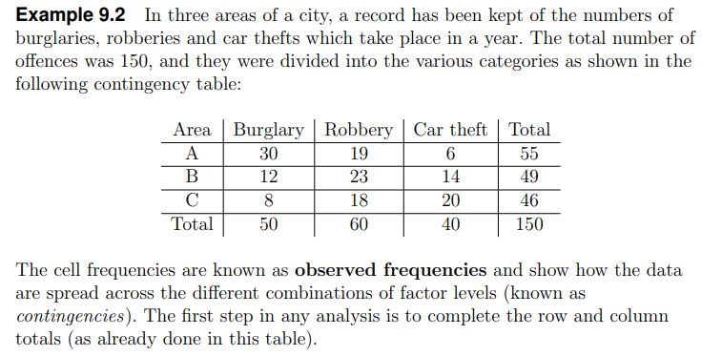
Example

Slide 17
Hypothesis
H0: No association between offences and areas of the city
H1: Association between offences and areas of the city

Slide 18
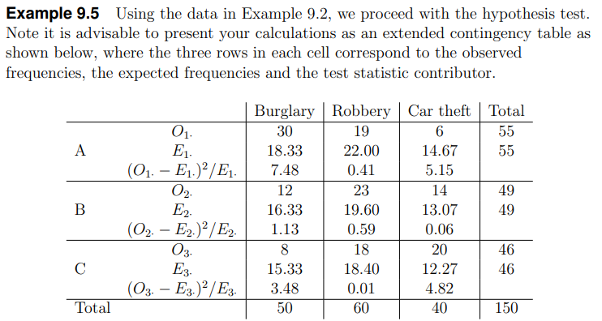
Observed and expected counts/frequencies

Slide 19
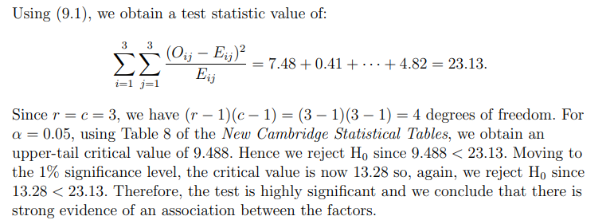

Slide 20
Test of independence_exercise
Consider an example on seed segregation
Colour
Yellow Green
Shape Round 315 108
Wrinkled 101 32
Hypothesis
Ho: The colour of the seed is independent of the shape
Ha: The colour of the seed is NOT independent of the shape
Chi-square value= 0.116, df=1

Slide 21
X² -Test for goodness of fit
Used to test if the hypothesized proportions given by the null hypothesis fits the data.
Example suppose a random sample of size n is classified into k categories or cells
Use X² -test for goodness of fit on k-1 degrees of freedom.
See pages 508-509

Slide 22
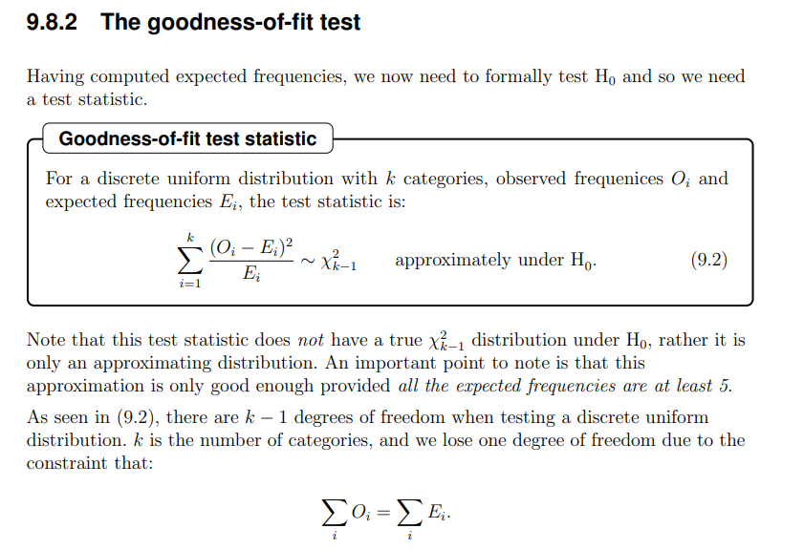
Formula: Goodness of fit test statistic

Slide 23
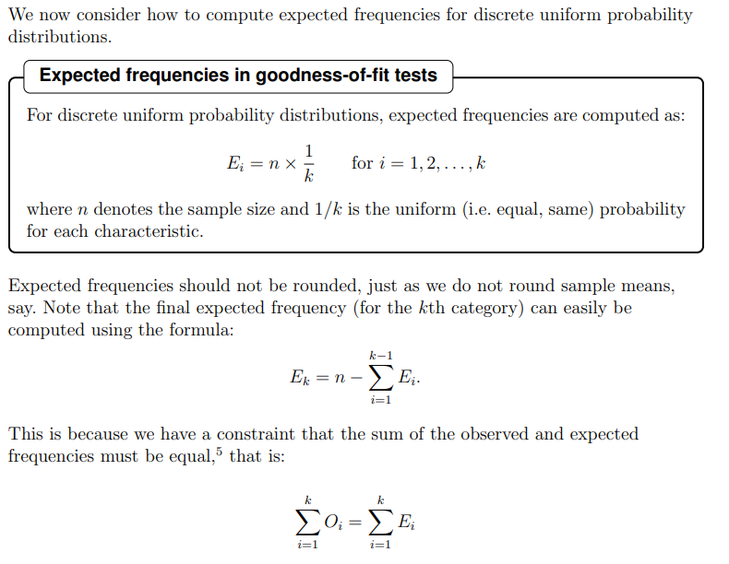
Formula: Expected frequencies in goodness of fit

Slide 24
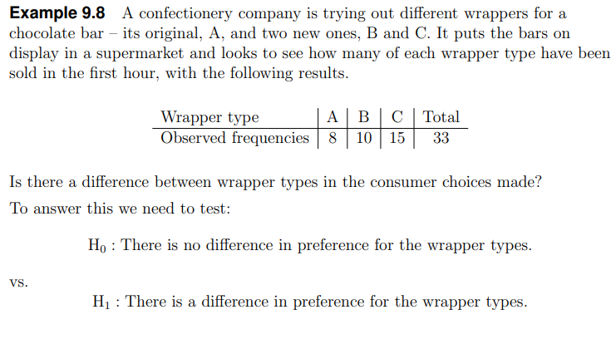
Example One

Slide 25
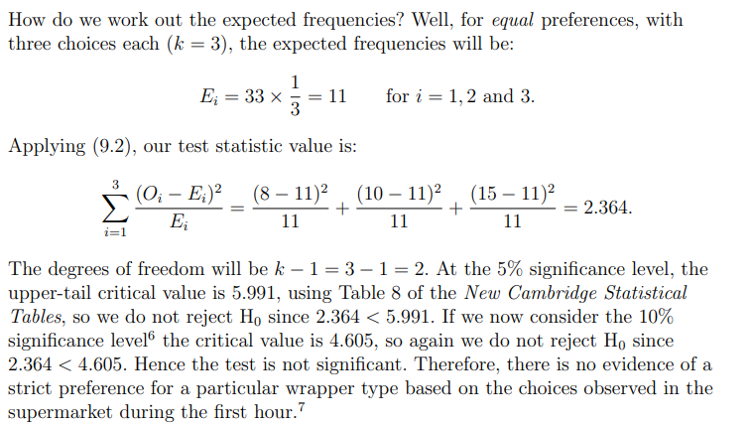

Slide 26
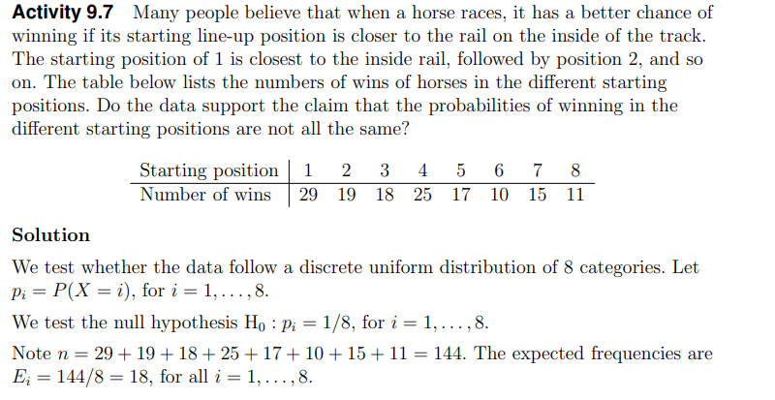
Example Two

Slide 27
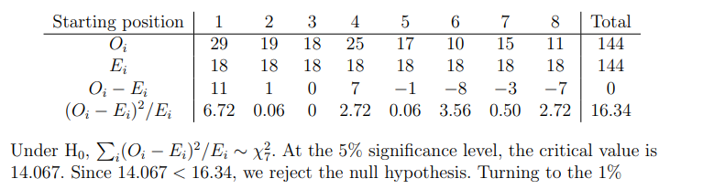
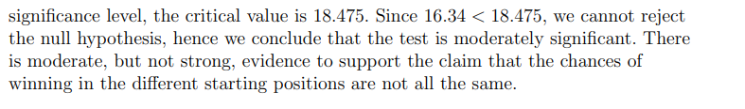

Slide 28
Test of goodness of fit_exercise
Consider a random sample of 90 blood samples
Group: O A B AB
Number: 41 27 17 7
Suppose the distribution of blood groups within the population is known to be
Group: O A B AB
Proportion: 0.454 0.365 0.116 0.065
Want to test
Ho: P₁ =0.454, P₂=0.365, P₃=0.116, P₄=0.065

Slide 29
Practical
Analysis of Categorical data in R

